Slide 1
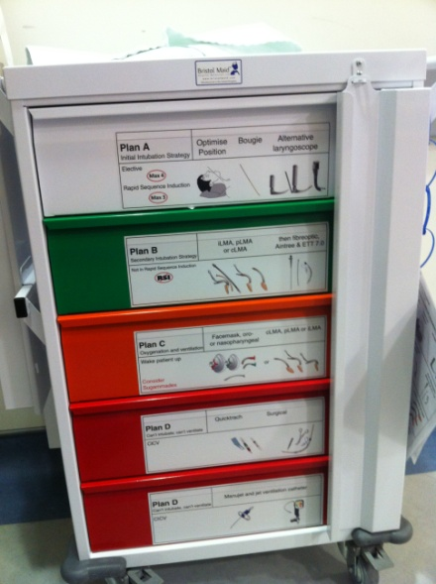
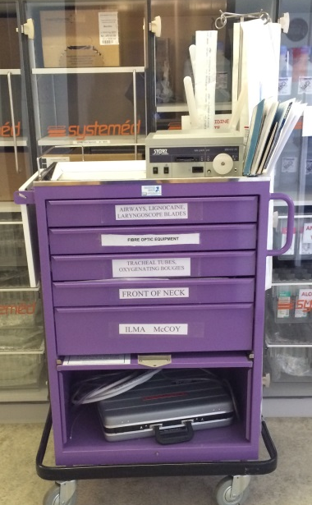
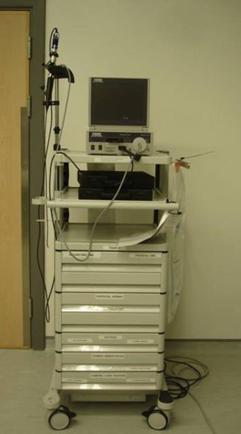
Difficult Airway Trolley
(DAT)
What does the ideal DAT look like?
Top work surface and 4-5 drawers
Mobile
Robust
Stocked in a logical sequence
Clearly labelled
Easily cleaned
Attached documentation
DAS/modified local guidelines
Checklist for restocking
Logbook for daily checking
Reproducible

Slide 2
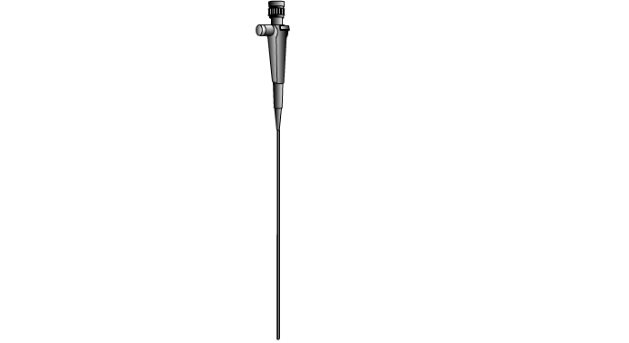
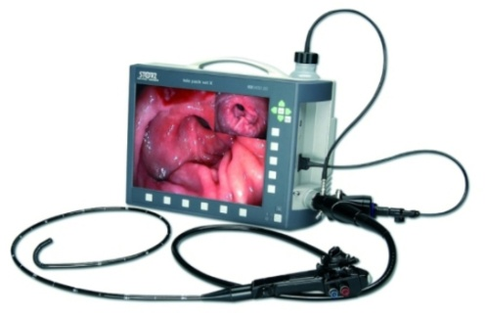
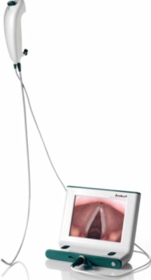
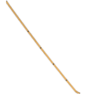
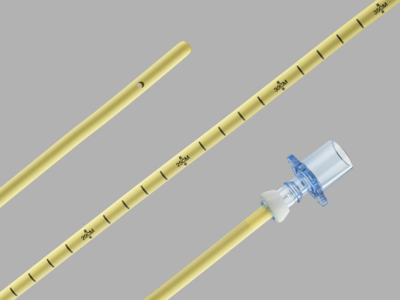
Top of trolley
Flexible intubating fibrescope
portable scope with battery light source
portable stack system
e.g. Storz Tele Pack
or single use fibrescope
e.g. Ambu aScope
Side of trolley
Bougies – adult and paediatric
Aintree Intubation Catheter
Airway exchange catheter

Slide 3
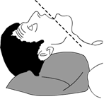
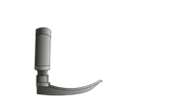
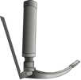
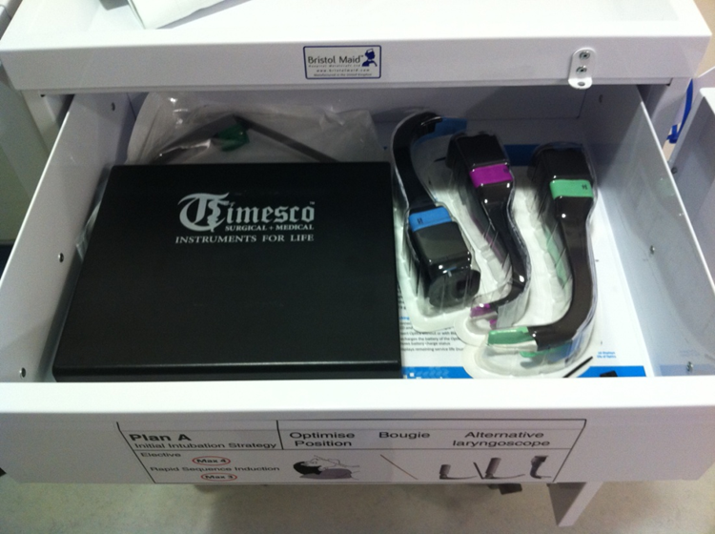
Drawer 1 – Plan A
Optimise head position
Bougie
Alternative laryngoscope
Contents
Bougie (ideally on side of trolley)
Short handle laryngoscope
McCoy blade and/or straight blade
Videolaryngoscope

Slide 4
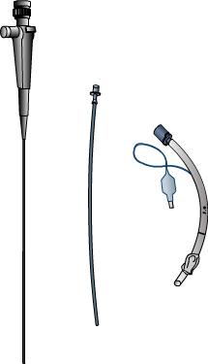
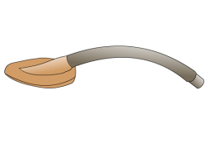
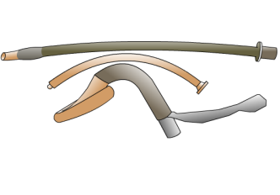
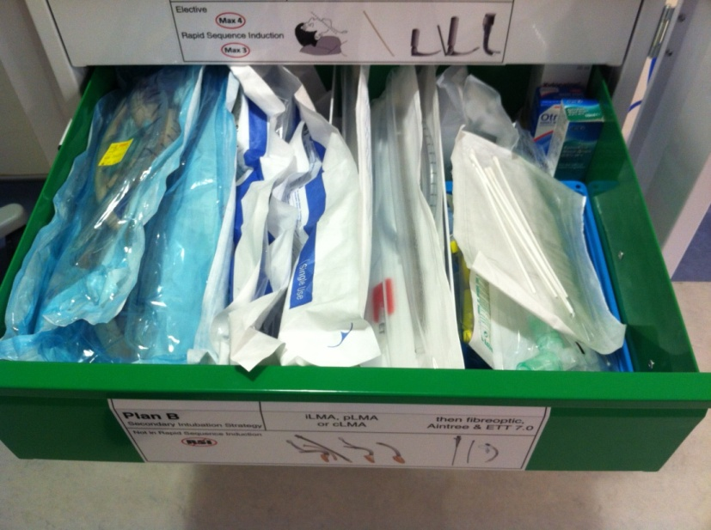
Drawer 2 – Plan B
LMA
Followed by fibreoptic tracheal intubation through LMA
Contents
LMA #3,4,5 &/or 2nd generation device #3,4,5
Intubating LMA (iLMA) #3,4,5
Aintree Intubating Catheter (ideally on side of trolley)
Fibreoptic adjuvants*

Slide 5
Drawer 2 – Plan B
Fibreoptic adjuvants*
Berman/Ovassapien airways
Mucosal atomisation devices
Fibrescope-compatible angle connector
Nasal sponge
4% lignocaine
10% lignocaine
Instillagel
Co-phenylcaine
(*Alternatively these can be stored in a separate
storage box which accompanies the trolley)

Slide 6
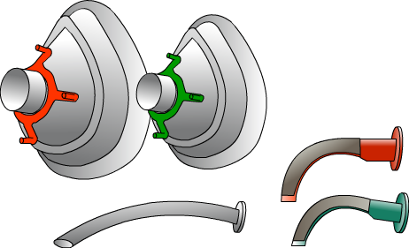
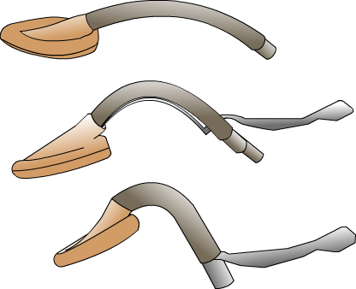
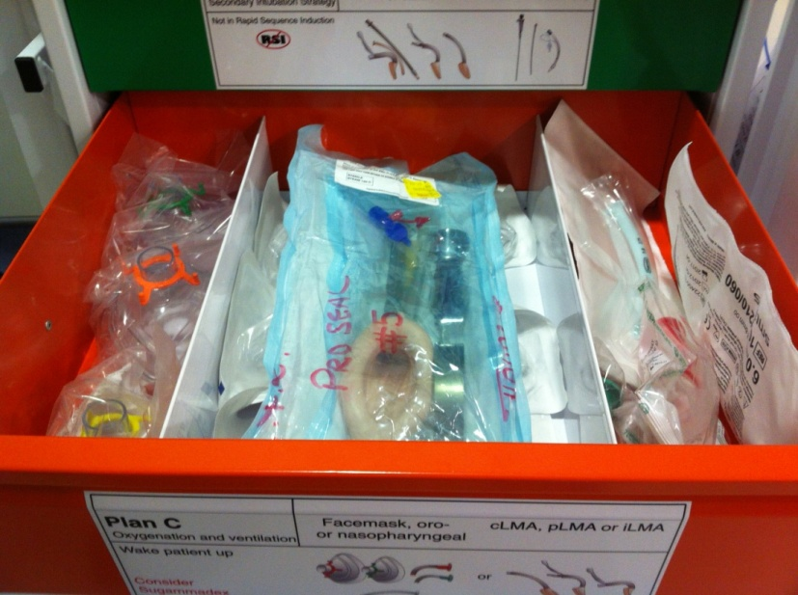
Drawer 3 – Plan C
Bag mask ventilation +/- airway adjuncts
Supraglottic airway device
Contents
Facemasks – various sizes
Oropharyngeal airways – various sizes
Nasopharyngeal airways – various sizes
LMA/Proseal LMA - #3,4,5

Slide 7
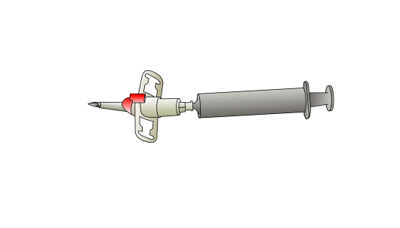
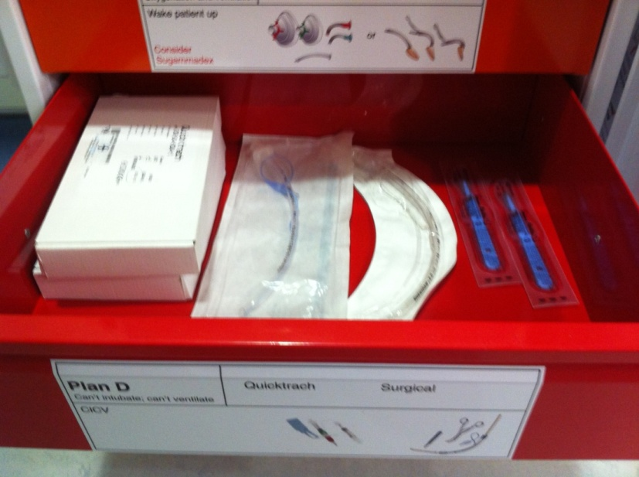
Drawer 4 – Plan D
Surgical cricothyroidotomy
Contents
Large bore cannula device
eg. Quicktrach I or II (VBM)
Scalpel (No. 20 blade)
Tracheal dilator or tracheal hook
Bougie
Cuffed tracheal tube #6 & 7

Slide 8
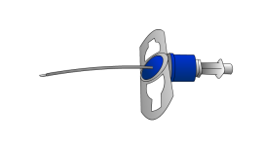
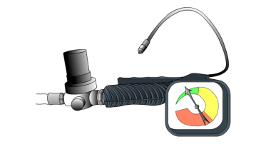
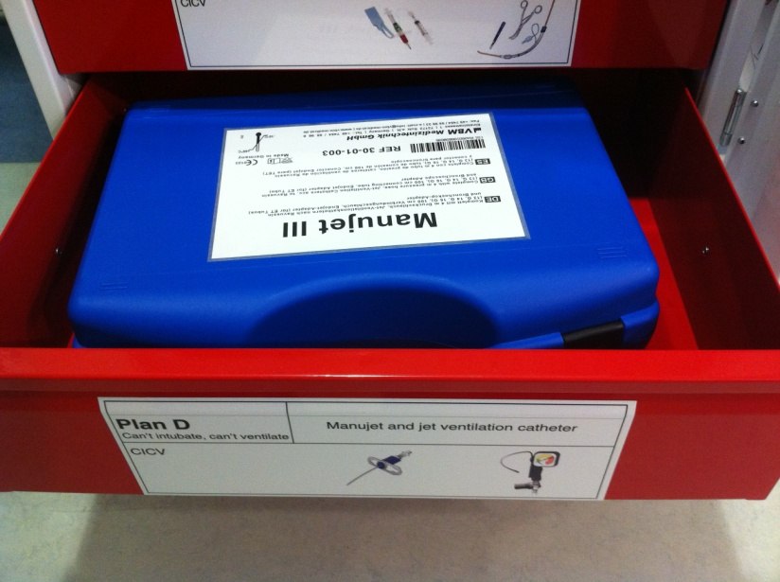
Drawer 5 – Plan D
Cannula cricothyroidotomy
Contents
Kink-resistant jet ventilation cannula
e.g. Ravussin (VBM)
High &/or low pressure ventilation system
e.g. Manujet III (VBM)
Ventrain (Ventinova)

Slide 9
Miscellaneous
DAS intubation guidelines (laminated)
Or locally agreed algorithms
Equipment checklist for re-stocking
Logbook for daily checking procedures
May also consider:
Specific extubation aids/equipment
eg. Staged Extubation Set (Cook Medical)
Extubation guidelines (laminated)

Slide 10
Plan vs Strategy
An airway plan suggests a single approach to management of the airway.
An airway strategy is a co-ordinated, logical sequence of plans, which aim to achieve good gas exchange and prevention of aspiration.
Anaesthetists should approach airway management with strategies rather than plans.
Difficult Airway Management Strategy (DAMS)
Generic strategy before each list/case
Specific strategy before anticipated difficult airway cases
Reinforces
Knowledge
Preparation
Teamwork

Slide 11
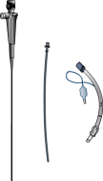
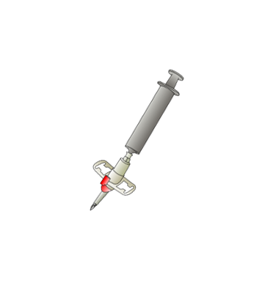
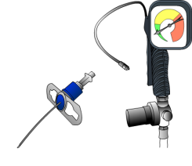
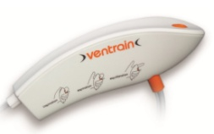
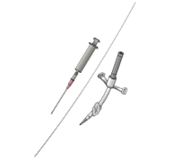
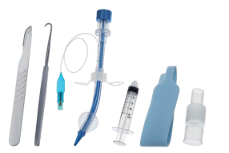
Suggestions for drawer labels
Plan A Initial intubation strategy | Optimise Bougie Alternative position laryngoscope
Remember to move on if not making progress
Plan B Secondary intubation strategy | LMA device Fibreoptic intubation
Remember to move on if not making progress
Plan C Maintain oxygenation | Facemask LMA device +/- airway adjunct
Postpone surgery Awaken patient
Plan D Can’t intubate, can’t ventilate | Cannula cricothyroidotomy
Remember to move on if not making progress
Plan D Can’t intubate, can’t ventilate | Surgical cricothyroidotomy
Remember to move on if not making progress

Slide 12
Drawer Labels
The drawer labels can be customised as required to illustrate the particular type of equipment present in the various drawers.
The specific make and model of equipment should be agreed locally with regular, comprehensive and continued training provided for all relevant staff.
The examples of equipment given in these guidelines serve only as a guide and should not be considered as absolute recommendations by DAS.

Slide 13
Remember
A clearly labelled trolley will also serve as a visual guide and prompt one to move along the strategy if not making progress.
What is most important is providing:
the right equipment
in the right amount
in the right place
at the right time
Know what you need - PLAN
Know who you need - COMMUNICATE
Have what you need - PREPARE
Do what you need - TRAIN

